Slide 1
NEGOTIATION AND CONFLICT MANAGEMENT Individual Differences

Slide 2

Individual Assessments
Thomas-Kilmann conflict mode
Big Five personality traits
Political skill

Slide 3
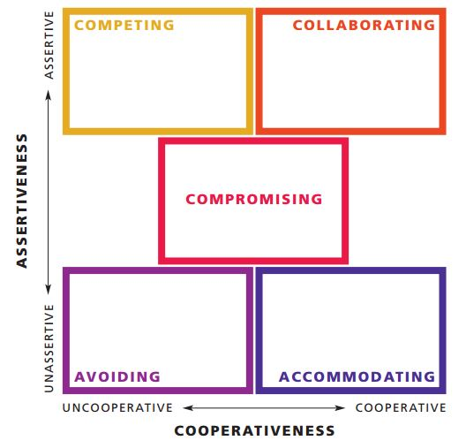
Thomas-Kilmann

Slide 4
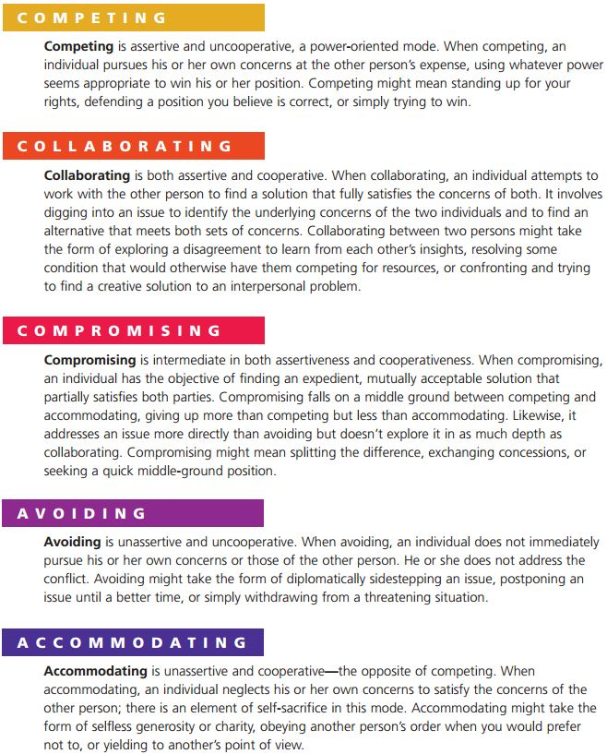
Individual Differences

Slide 5
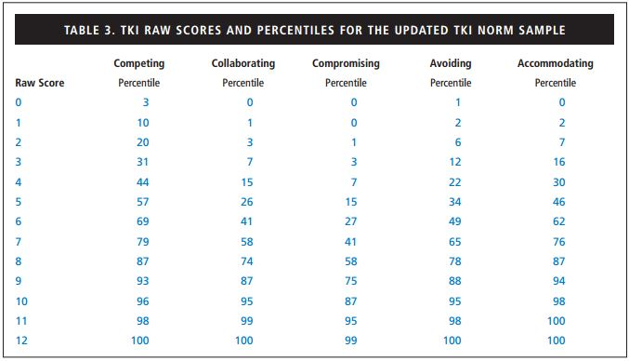
Thomas-Kilmann
Thomas-Kilmann conflict mode instrument percentiles

Slide 6
Big Five Personality
Openness to experience
Curious, imaginative, creative, complex, and sophisticated
Conscientiousness
Reliable, organized, ambitious, hardworking, and persevering
Extraversion
Talkative, sociable, passionate, assertive, bold, and dominant
Agreeableness
Warm, kind, cooperative, sympathetic, helpful, and courteous
Neuroticism
Nervous, moody, emotional, insecure, and jealous

Slide 7
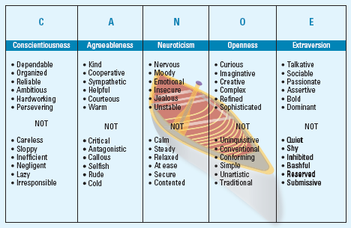
Big Five Personality

Slide 8

Political Skill
Political skill is defined as “the ability to understand others at work and to use that knowledge to influence others to act in ways that enhance one’s personal or organizational objectives” (Ferris et al., 2005).
Related to several positive outcomes, for example:
Job performance
Opportunity recognition and capitalization
Reputation
Acquisition of resources
Political skill has four facets:
Social astuteness
Interpersonal influence
Networking ability
Apparent sincerity

Slide 9
Political Skill
Social astuteness – the ability to comprehend social interactions and accurately interpret their own behavior and the behavior of others.
Interpersonal influence – the ability to use subtle and convincing personal style to exert a powerful influence on those around them.
Networking ability – the ability to easily develop friendships, build strong alliances, and position oneself to both create and take advantage of opportunities.
Apparent sincerity – the ability to display integrity, authenticity, sincerity, and genuineness (real or faked).

Slide 10
Individual Assessments
If you have not already, please complete the assessments (answer items honestly) and consider whether you believe each assessment is accurate. Why or why not?
How might certain characteristics affect your performance in negotiation? Will certain characteristics help you? Will others hurt you?
What do you want to address/work to promote/position throughout the semester?
There are no right or wrong answers; these assessments are for your own use and are intended to help you be more self-aware of your tendencies
Knowledge is power. This includes not only knowledge regarding specifics of the negotiation, but also knowledge of negotiator characteristics (i.e., you and the other party)
How can you use your characteristics to your advantage?
Throughout the semester we will address these assessment results and associated tactics/strategies that work with different characteristics

Slide 11
Assignment
Individual Assessments assignment on Canvas due February 1

Slide 12
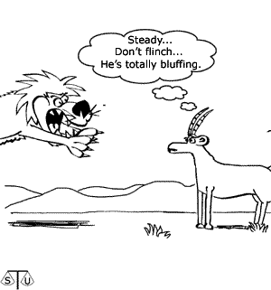
Why learn to negotiate?

